Slide 1
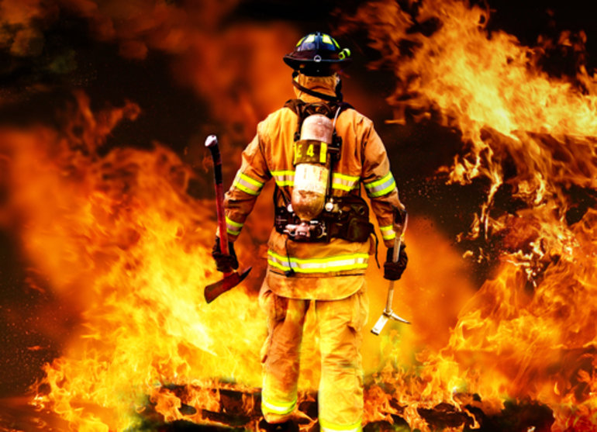
TriageTag RFID System
A System That Saves Lives
By: TriageTag Team
[1]
Notes:
Today, we will be giving a briefing on our Senior Design project, TriageTag RFID System.

Slide 2
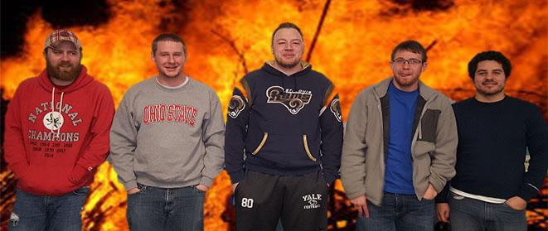
Our Team
Troy Caplinger - Electrical Engineering student
Robert Lang - Electrical Engineering student
Jonathan Carpenter - Computer Science student
Vincent Haenni - Electrical Engineering Student
Anthony Inman - Computer Science student
From left to right: Troy, Robert, Vincent, Anthony, Jonathan
Notes:
The members of the Triage Team are Troy Caplinger, Robert Lang, Vincent Haenni, Anthony Inman, and Jonathan Carpenter. We are a well balanced unit with both computer and electrical engineering experience. Each member is a senior in their degree program at Wright State University and plan to graduate either in the Fall of this year or Spring of 2017.

Slide 3
Overview
Overview
Problem
Market Analysis
Solution
Selection of Constraints and Requirements
System Components
Impact of Success
Conclusion
Recap
References
Thank you
Notes:
Here is a quick overview of what we’ll be discussing today.

Slide 4
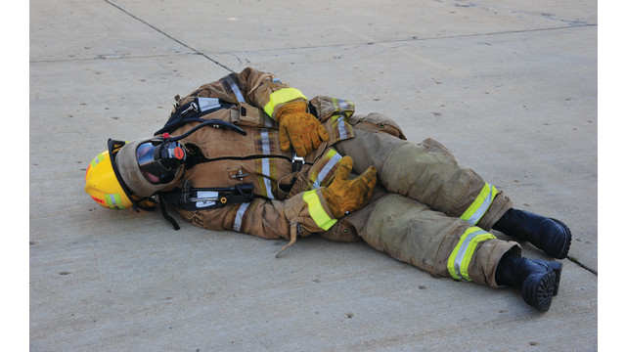
Problem
Firefighters can become severely injured during mass casualty events
Injured firefighters can be uncommunicative and difficult to identify
Patient medical information can be hard to obtain on site of an incident
Lack of information during patient care in route to treatment site
[3]
Notes:
Talking points:
During recent mass casualty events, such as Hurricane Katrina or 9/11, firefighters are some of the first to respond. When they become injured, they are no longer considered first responders, but victims. Once this occurs, they are then entered into the triage process, where triage personnel must assign a severity of injury or triage level. This level can be difficult to determine accurately, especially if the firefighter is unresponsive. If there are on site treatment facilities, then having relevant medical information can be the difference between life and death. The TriageTag system is designed to supply this life or death information.

Slide 5
Market Analysis
Existing Systems
RFID Patient Tracking Technology
Patients are marked with an RFID tag
Patients injury severity is uploaded to database
Injuries are instantly uploaded to the IC (Incident Commander)
Petfinder
Passive RFID tags are placed under the skin of the pet
Identification number is read from the RFID tag using an RFID scanner
Database entry has information on the pet owner
Electronic Cattle Management
RFID tags to track different characteristics of cattle owned by farmers
Allows modification of information to the local database
Notes:
Currently, there are already RFID systems in production for a variety of different purposes. One system designed for triage, involves tracking the number and severity of firefighter injuries and relaying that information to incident commander. Another similar system involves tagging livestock with passive RFID tags. When these tags are scanned with a RFID reader, a unique identification signal is sent the reader. From there, the farmer is able to view data in a database that corresponds to that animal. This information can be updated, altered, or deleted altogether. Finally, pets can be tagged with RFID tags. If a pet gets lost, a veterinarian can scan the animal, and if they have a tag, a unique identification signal is sent to the scanner which can be used to access an entry in a database with information on the pets owners, including phone number, email, or even their address.

Slide 6
Solution
TriageTag System
Radio frequency identification (RFID)
Unique identification of each RFID tag
One tag per firefighter
Passive
Database of medical information
Information provided by firefighters
Update and manage medical records
Portable
Secure access to data for triage personnel
Password protected
AES encryption
Source: Author; Jonathan Carpenter
Notes:
The TriageTag system is a dynamic approach that integrates RFID technology into the triage process. The process begins with each firefighter being equipped with an RFID tag that contains a unique identification signal. When an injured firefighter enters the medical facility the triage personnel then scans the firefighter’s RFID tag by supplying energy to the tag with the RFID scanner which then activates the RFID tag’s transmitter. The scanner then transmits the received unique identification signal via bluetooth connection to the mobile device. Once the mobile device receives the unique signal from the RFID scanner, this signal is used to query a database located on the mobile device. This query will retrieve identification and medical information that corresponds to the injured firefighter which can then be used to provide higher quality medical care.

Slide 7
Selection of Constraints and Requirements
Constraints
Health Insurance Portability and Accountability Act (HIPAA) [11] [14] [15].
Advanced Encryption Standard (AES) [13].
ISO/IEC 18000-63:2015 [12].
Requirements
User authentication to access the master database.
User authentication to access the local database
Passive RFID technology.
Notes:
This is a small selection of our constraints and requirements. Since personal medical information will be collected, the system must conform to HIPAA standards and get consent from the firefighters to use their information in the system. We felt that additional security was also necessary to protect the firefighters information, so the system encrypts the medical records according to AES. ISO/IEC 18000-63:2015 is the standard dealing with interfacing RFID tags and the RFID scanners in the 860 MHz to 960 MHz range, to ensure interoperability and compatibility. The first requirement was selected to further protect the firefighters personal information and to ensure that the medical information stored on the master database could only be changed by the appropriate user. We also decided to include user authentication on the local database to ensure that only authorized triage personnel can access the medical information. The user authentication will ensure that if a random person walks into the triage center and picks up a mobile device, they would not be able to access the database.The system will also rely on passive RFID technology in order to function.

Slide 8
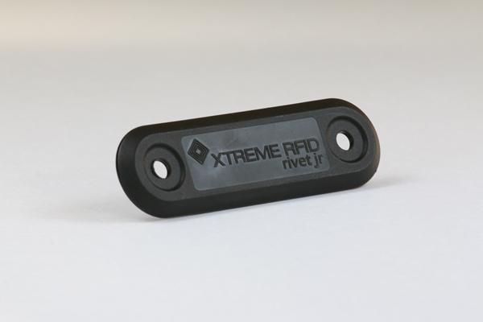
System Components
Xtreme RFID Rivet Jr
ISO 18000-6C Compliant
Operational frequency: 860 - 960 MHz
Operational temperature: -40ºC to 160ºC
Maximum water submersion depth: 4 km
Dimensions: 86 L x 25 W , 4 H (mm)
Weight: 6 grams
Information source: [2]
[9]
Notes:
Passive RFID tags do not have a built in energy storage device and transmit their information only when energized by an RFID scanner. Whereas active RFID tags have a built in energy source and transmit their signal without being energized by an RFID scanner. We chose passive RFID technology so that the firefighters do not have to worry about charging or replacing energy sources and to ensure the firefighter is not carrying the extra weight of the energy source. The Rivet Jr tag is a passive RFID tag that is small, durable, and complies to ISO 18000 which satisfies the constraints and requirements of the system.

Slide 9
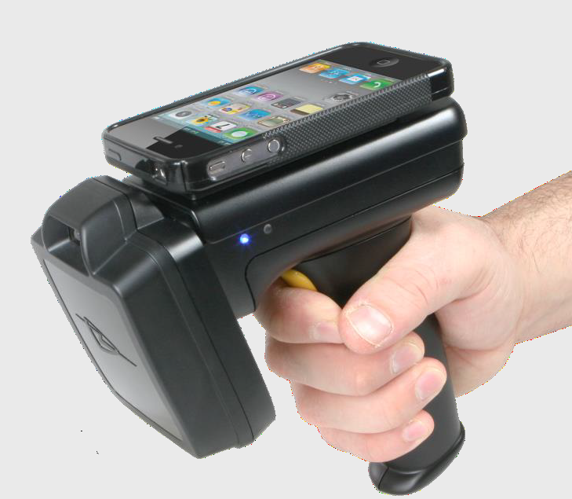
System Components continued...
TSL 1128 Bluetooth UHF RFID Reader
Operational frequency: 902 - 928 MHz
Operational temperature: -20ºC to 140º C
Bluetooth connectivity
Output power: 10mW to 800mW
Satisfies electrical safety standard: UL60950-1
Battery: rechargeable 2200 mAh battery
Information Source: [7]
[7]
Notes:
The function of the RFID scanner is to energize and receive the identification signal that is transmitted from the RFID tag. The scanner then relays this identification information to the TriageTag mobile device so that the triage personnel can identify and access medical information that pertains to the injured firefighter. The scanner that we chose for our system is the TSL 1128. The TSL 1128 operates in the same frequency range as the Rivet Jr RFID tag and can supply power to energize the RFID tag’s transmitter. The TSL 1128 has the bluetooth connectivity necessary to communicate with the TriageTag mobile device. The rechargeable battery and bluetooth connectivity makes this scanner portable and the simple, trigger-operated design makes it easy for triage personnel to use.

Slide 10
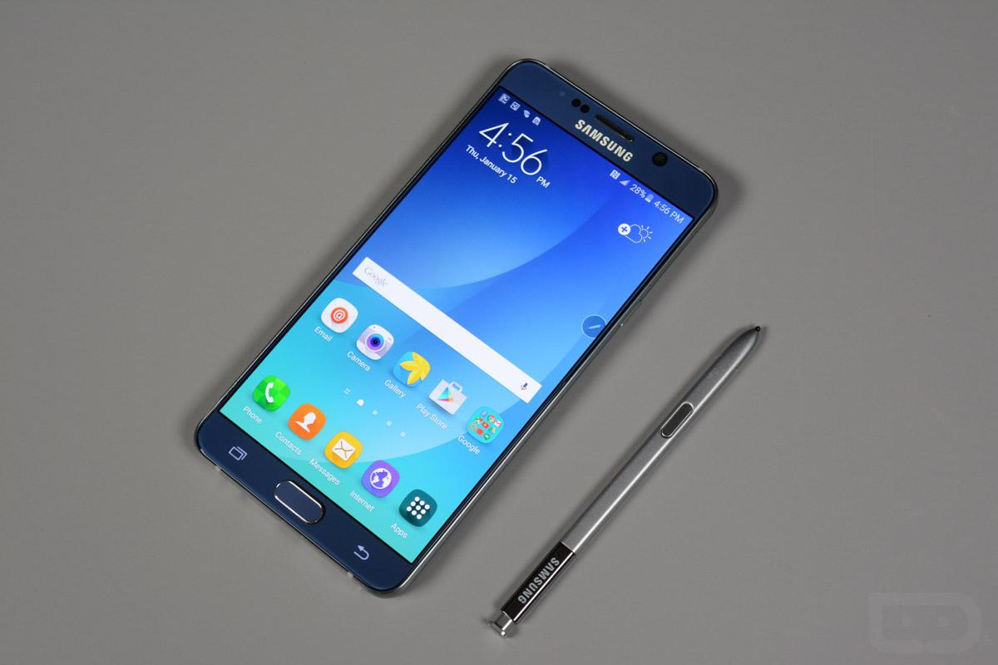
System Components continued...
Samsung Galaxy Note 5
S-pen stylus
USB 2.0
WiFi enabled
Bluetooth connectivity
32GB minimum internal memory
Information Source: [8]
[6]
Notes:
The Samsung Galaxy Note 5 was chosen as the mobile device. The mobile device allows the Triage personnel to access the medical information of injured firefighters. Triage personnel may have gloves when operating the system so the stylus that is equipped with the Note 5 will allow for device function when the gloves are not compatible with the touch screen of the device. The Note 5 is also equipped with 32 Gigabites of memory which will allocate enough memory for the local database and TriageTag application to be stored on the the device. Since the local database on each device must be synchronized to the master database, the Note 5’s Wifi capabilities will enable this synchronization to be done via WiFi connection. The Note 5 also has bluetooth connectivity to connect and receive information from the TriageTag RFID scanner. The WiFi and Bluetooth functionality of our system allows for wireless interfacing between all of the TriageTag system components.

Slide 11
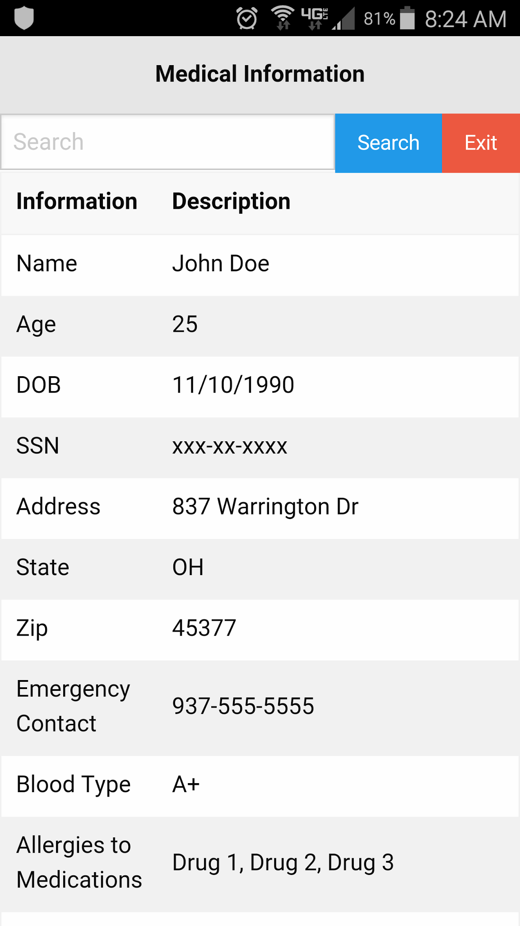
System Components continued...
Medical Information Database
SQLite database
SQLiteCrypto AES-256bit Encryption
Users are mapped to an Extensible Markup Language (XML) file containing medical information
Editable medical records
Password protected
Source: Author; Jonathan Carpenter
Notes:
==.> The Medical Information Database will provide a mapping of medical information to firefighters.
The medical information will be stored as xml files and will be encrypted to protect the firefighters
information.
== > A firefighter can edit his/her own medical information to reflect their current health status.
== > Each user of the system will have a username and password to ensure appropriate use of the system
== > To the right is a mock-up of what the medical professional will see when they retrieve the medical information of a firefighter.

Slide 12
Impact of Success
System Use
The TriageTag system will allow triage personnel to lookup medical information for firefighters.
The Triage personnel will have to scan the TriageTag RFID tags located on firefighters using the TriageTag scanner.
A unique signal corresponding to a firefighter will be returned to the scanner
Will allow the user to retrieve the firefighters medical information from the local database
Changes that will occur from system success
The TriageTag system will provide a means to store and retrieve medical information to help expedite the triage process.
The TriageTag system will give triage personnel immediate access to important medical information.
The TriageTag system will improve the quality of care given to injured firefighters.
Notes:
The TriageTag system will improve how effectively injured firefighters can be treated. It will give triage personnel medical information that typically wasn’t available on site in the past. This medical information can help assess the severity of the injuries of firefighters and improve patient care as an injured firefighter is being treated on site or en route to a treatment facility.

Slide 13
Conclusion
Systems utilizing RFID technology to track information in a database currently exist, showing that our system is feasible and an adequate solution.
The TriageTag system can help identify unconscious or unresponsive firefighters.
The TriageTag system can also help triage personnel identify pre-existing conditions that could alter the triage level assigned to the firefighter.
Pharmaceutical allergies
High blood pressure
Clotting factors
The TriageTag system is designed to protect the firefighters personal information.
Medical information
Personal identification information
Notes:
The TriageTag system is a dynamic process that can help make the triage of injured firefighters more efficient and accurate. If this system is implemented, it will help save lives. This system can also be expanded to include police officers, search and rescue, and even military in deployed locations.

Slide 14
Recap
Introduction
Problem
Market Analysis
Solution
Selection of Constraints and Requirements
System Components
Impact of Success
Conclusion
Recap
References
Thank you
Notes:
Here is a brief recap of the topics covered in this briefing.

Slide 15
References
[1] Wood, Colin. (March 26, 2013). Holograms Add New Dimension to Fighting Fire. [Online]. Available: http://www.govtech.com/public-safety/Holograms-Add-New-Dimension-to-Fighting-Fire.html [Date Accessed: April 6, 2016]
[2] Cascade Engineering. (2014). XTREME RFID Rivet Jr Tag. [Online]. Available: http://xtremerfid.com/xtreme-tag%C2%AE-rivet-jr [Date Accessed: April 6, 2016] [3]Alexander, John G., Stephens, Christopher T. (June 1, 2013). How to Assess and Treat Injured Firefighters. [Online]. Available: http://www.emsworld.com/article/10934759/Firefighter-injuries [Date Accessed: April 6, 2016] [4] Department of Homeland Security. (2013). RFID Triage Tags. [Online]. Available: http://www.firstresponder.gov/SAVER/Documents/RFID-Triage-Tags-TN_0913-508.pdf [Date Accessed: April 13, 2016 ] [5] Honeywell. (2016). Seattle Fire Department Field Tests RFID Patient Tracking Technology. Available: http://www.intermec.com/learning/content_library/case_studies/cs1940.aspx [Date Accessed: April 13, 2016]
Notes:
Here is a list of all of the references used in this presentation.

Slide 16
References continued...
[6]Kellex. (August 17, 2015). Galaxy Note 5 Unboxing and First Impressions. [Online]. Available: http://www.droid-life.com/2015/08/17/galaxy-note-5-unboxing/ [Date Acccessed: April 13, 2016]
[7] Technology Solutions Ltd. (2013). 1128 Bluetooth UHF RFID Reader. [Online]. Available: http://www.barcodediscount.com/pdf/TSL/1128.pdf [Date Accessed: March 21, 2016] [8] Samsung Electronics Co., Ltd. (2016). Samsung Galaxy Note 5. [Online]. Available: http://www.samsung.com/us/explore/galaxy-note-5-features-and-specs/?cid=ppc- [Date Accessed: March 30, 2016] [9] VERYFIELDS. (2011). Xtreme RFID Xtreme Tag Rivet Jr. [Online]. Available: http://www.veryfields.net/ rfid-tags-Xtreme+RFID+Xtreme+Tag+Rivet+Jr.html [Date Accessed: April 13, 2016] [10] Wikipedia. (June 21, 2012). File:Large Bonfire.jpg. [Online]. Available: https://en.wikipedia.org/wiki/File:Large_bonfire.jpg [Date Accessed: April 13, 2016]
[11] Federal Register National Archives and Records Administration. (October 1, 2007). 45 CFR 160. [Online]. Available: https://www.gpo.gov/fdsys/pkg/CFR-2007-title45-vol1/pdf/
CFR-2007-title45-vol1.pdf [Date Accessed: April 1, 2016]

Slide 17
References continued...
[12] International Organization of Standards. (2016). ISO/IEC 18000-63:2015. [Online]. Available: http://www.iso.org/iso/home/store/catalogue_ics/catalogue_detail_ics.htm?
csnumber=63675 [Date Accessed: March 30, 2016]
[13] National Institute of Standards and Technology. (November 26, 2001). FIPS PUBS 197 Advanced Encryption Standard. [Online]. Available: http://csrc.nist.gov/publications/fips/fips197/fips-197.pdf [Date Accessed: April 4, 2016]
[14] Federal Register National Archives and Records Administration. (October 1, 2007). 45 CFR 162. [Online]. Available: https://www.gpo.gov/fdsys/pkg/CFR-2007-title45-vol1/pdf/
CFR-2007-title45-vol1.pdf [Date Accessed: April 1, 2016]
[15] Federal Register National Archives and Records Administration. (October 1, 2007). 45 CFR 164. [Online]. Available: https://www.gpo.gov/fdsys/pkg/CFR-2007-title45-vol1/pdf/
CFR-2007-title45-vol1.pdf [Date Accessed: April 1, 2016]

Slide 18
Thank you
If you have any additional questions, contact us at the following email addresses.
Troy Caplinger: caplinger.14@wright.edu
Robert Lang: lang.35@wright.edu
Jonathan Carpenter: carpenter.102@wright.edu
Anthony Inman : inman.22@wright.edu
Vincent Haenni : haenni.2@wright.edu
Notes:
Thank you for your time. Please email any member of the Triage Team at any of the following email addresses if you have any questions regarding the material covered in this presentation.

